Slide 1

CODER HOUSE PROYECTO BASES DE DATOS FORMULA 1
IBARRA SERGIO
JUNE 2023

Slide 2
DATASET: Se decidió usar un dataset de Kaggle con información histórica de carreras de la formula 1
Se extrajo información acerca de cada Carrera en el ciruito professional de formula 1 desde el año 2009 hasta el 2022.
Esta información está dividida en muchas tablas tales como: circuits. cricuits_results , constructor_standings , constructors, driver_standings, drivers, lap_times, pin_stops, qualifiying, races, results, seasons, sprint_results, status.
Notes:
Seasonality, trend and noise in time series data | Python (datacamp.com)

Slide 3
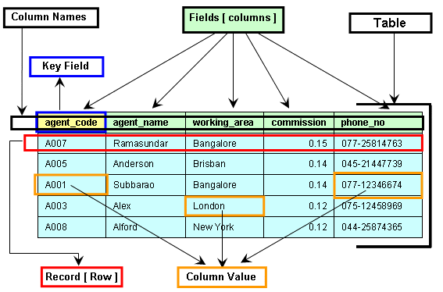
Definiendo las distintas entidades y sus campos

Slide 4
Se decidió usar un dataset de Kaggle con información histórica de carreras de la formula 1
Table: Constructors
Field | Type of Data
constructurID (PK) | Int
constructurRef | varchar
name | Varchar
Nationality | Varchar
utl | Varchar
Table: Circuits
Field | Type of Data
circuitID (PK) | Int
circuitRef | varchar
name | Varchar
location | Varchar
Country | Varchar
lat | Float
lng | Float
alt | Float
url | Varchar
Table: Constructors_results
Field | Type of Data
constructorResultsId (PK) | Int
raceId (FK on Race(raceID)) | Int
constructorId (FK on Constructors(constructorId)) | Int
Points | Int
Status | Varchar
Table: Constructors_stadings
Field | Type of Data
constructorStandingsId (PK) | Int
raceId (FK on Race(raceID)) | Int
constructorId (FK on Constructors(constructorId)) | Int
Points | Int
Position | Int
PositionText | Int
Wins | Int
Notes:
Seasonality, trend and noise in time series data | Python (datacamp.com)

Slide 5
Se decidió usar un dataset de Kaggle con información histórica de carreras de la formula 1
Table: Drivers
Field | Type of Data
driverId (PK) | Int
driverRef | varchar
number | Varchar
Code | Varchar
Forename | Varchar
surname | Varchar
dob | Date
nationality | Varchar
url | Varchar
Table: Lap_times
Field | Type of Data
raceId (FK on Race(raceID)) | Int
driverId (FK on Drivers(driverID)) | Int
lap (PK) | Int
position | Int
time | Varchar
miliseconds | Int
Table: Driver_standings
Field | Type of Data
driverStandingsId(PK) | Int
raceId (FK on Race(raceID)) | Int
driverId (FK on Drivers(driverID)) | Int
Points | Int
Position | Int
PositionText | Int
Wins | Int
Table: pit_stops
Field | Type of Data
raceId (FK on Race(raceID)) | Int
driverId (FK on Drivers(driverID)) | Int
stop (PK) | Int
lap(FK on lap_times(lap)) | Int
Wins | Int
time | Varchar
duration | float
miliseconds | Int
Notes:
Seasonality, trend and noise in time series data | Python (datacamp.com)

Slide 6
Table: results
Field | Type of Data
resultID(PK) | Int
raceId (FK on Race(raceID)) | Int
driverId (FK on Drivers(driverID)) | Int
constructurID (PK) (FK on Constructor(constructorID)) | Int
number | Int
Grid | Int
position | Int
PositionText | Int
PositionOder | Int
position | Int
laps | Int
time | Varchar
miliseconds | Int
fastestLap | Int
rank | Int
fastestLapTime | Varchar
fastestLapSpeed | Float
statusId | Int
Table: races
Field | Type of Data
raceId (PK) | Int
year | Int
round | Int
circuitID (FK on Cicruits(circuitID)) | Int
name | Varchar
date | Date
time | Varchar
url | Varchar
fp1_date | Date
fp1_time | Varchar
fp2_date | Date
fp2_time | Varchar
fp3_date | Date
fp3_time | Varchar
quali_date | Date
quali_time | Varchar
sprint_date | Date
sprint_time | Varchar
Table: qualifiying
Field | Type of Data
qualifyId (PK) | Int
raceId (FK on Race(raceID)) | Int
driverId (FK on Drivers(driverID)) | Int
constructurID (FK on Constructor(constructorID)) | Int
number | Int
position | Int
q1 | Varchar
q2 | Varchar
q3 | Varchar
q4 | Varchar
Notes:
Seasonality, trend and noise in time series data | Python (datacamp.com)

Slide 7
Se decidió usar un dataset de Kaggle con información histórica de carreras de la formula 1
Table: sprint_results
Field | Type of Data
resultId(PK) | Int
raceId (FK on Race(raceID)) | Int
driverId (FK on Drivers(driverID)) | Int
constructurID (FK on Constructor(constructorID)) | Int
number | Int
Grid | Int
position | Int
PositionText | Int
PositionOder | Int
position | Int
laps | Int
time | Varchar
miliseconds | Int
fastestLap | Int
fastestLapTime | Varchar
statusId | Int
Table: Seasons
Field | Type of Data
year | Int
url | varchar
Table: Status
Field | Type of Data
StatusID (PK) | Int
status | varchar
Notes:
Seasonality, trend and noise in time series data | Python (datacamp.com)

Slide 8
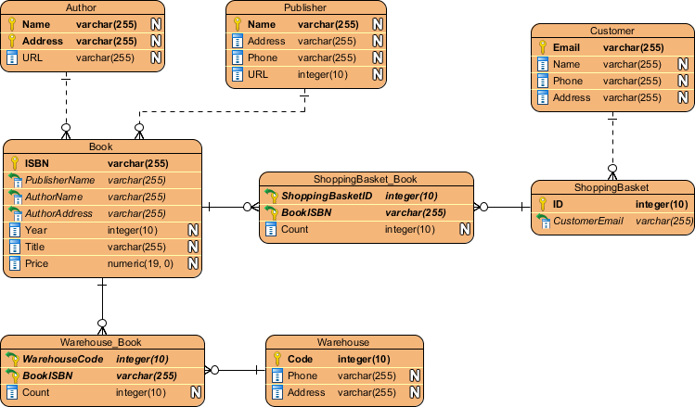
Definiendo las relaciones entre las distintas entidades

Slide 9
Se presenta la relación entre la distintas entidades de nuestra base Formula1
Table: races
Field | Type of Data
raceId (PK) | Int
year | Int
round | Int
circuitID (FK on Cicruits(circuitID)) | Int
name | Varchar
date | Date
time | Varchar
url | Varchar
fp1_date | Date
fp1_time | Varchar
fp2_date | Date
fp2_time | Varchar
fp3_date | Date
fp3_time | Varchar
quali_date | Date
quali_time | Varchar
sprint_date | Date
sprint_time | Varchar
Table: sprint_results
Field | Type of Data
resultId(PK) | Int
raceId (FK on Race(raceID)) | Int
driverId (FK on Drivers(driverID)) | Int
constructurID (FK on Constructor(constructorID)) | Int
number | Int
Grid | Int
position | Int
PositionText | Int
PositionOder | Int
position | Int
laps | Int
time | Varchar
miliseconds | Int
fastestLap | Int
fastestLapTime | Varchar
statusId | Int
Table: Drivers
Field | Type of Data
driverId (PK) | Int
driverRef | varchar
number | Varchar
Code | Varchar
Forename | Varchar
surname | Varchar
dob | Date
nationality | Varchar
url | Varchar
1:N
1:N
1:1
Table: Circuits
Field | Type of Data
circuitID (PK) | Int
circuitRef | varchar
name | Varchar
location | Varchar
Country | Varchar
lat | Float
lng | Float
alt | Float
url | Varchar
N:1
Table: Constructors
Field | Type of Data
constructurID (PK) | Int
constructurRef | varchar
name | Varchar
Nationality | Varchar
utl | Varchar
1:N
Table: results
Field | Type of Data
resultID(PK) | Int
raceId (FK on Race(raceID)) | Int
driverId (FK on Drivers(driverID)) | Int
constructurID (PK) (FK on Constructor(constructorID)) | Int
number | Int
Grid | Int
position | Int
PositionText | Int
PositionOder | Int
position | Int
laps | Int
time | Varchar
miliseconds | Int
fastestLap | Int
rank | Int
fastestLapTime | Varchar
fastestLapSpeed | Float
statusId | Int
1:N
1:1
N:1
Table: qualifiying
Field | Type of Data
qualifyId (PK) | Int
raceId (FK on Race(raceID)) | Int
driverId (FK on Drivers(driverID)) | Int
constructurID (FK on Constructor(constructorID)) | Int
number | Int
position | Int
q1 | Varchar
q2 | Varchar
q3 | Varchar
q4 | Varchar
1:1
1:1
1:1
Table: Driver_standings
Field | Type of Data
driverStandingsId(PK) | Int
raceId (FK on Race(raceID)) | Int
driverId (FK on Drivers(driverID)) | Int
Points | Int
Position | Int
PositionText | Int
Wins | Int
1:N
1:1
Table: Lap_times
Field | Type of Data
raceId (FK on Race(raceID)) | Int
driverId (FK on Drivers(driverID)) | Int
lap (PK) | Int
position | Int
time | Varchar
miliseconds | Int
1:N
N:1
Table: pit_stops
Field | Type of Data
raceId (FK on Race(raceID)) | Int
driverId (FK on Drivers(driverID)) | Int
stop (PK) | Int
lap(FK on lap_times(lap)) | Int
Wins | Int
time | Varchar
duration | float
miliseconds | Int
1:N
N:1
1:1
Table: Constructors_results
Field | Type of Data
constructorResultsId (PK) | Int
raceId (FK on Race(raceID)) | Int
constructorId (FK on Constructors(constructorId)) | Int
Points | Int
Status | Varchar
1:N
1:1
Table: Constructors_stadings
Field | Type of Data
constructorStandingsId (PK) | Int
raceId (FK on Race(raceID)) | Int
constructorId (FK on Constructors(constructorId)) | Int
Points | Int
Position | Int
PositionText | Int
Wins | Int
1:N
1:1
Notes:
Seasonality, trend and noise in time series data | Python (datacamp.com)

Slide 10
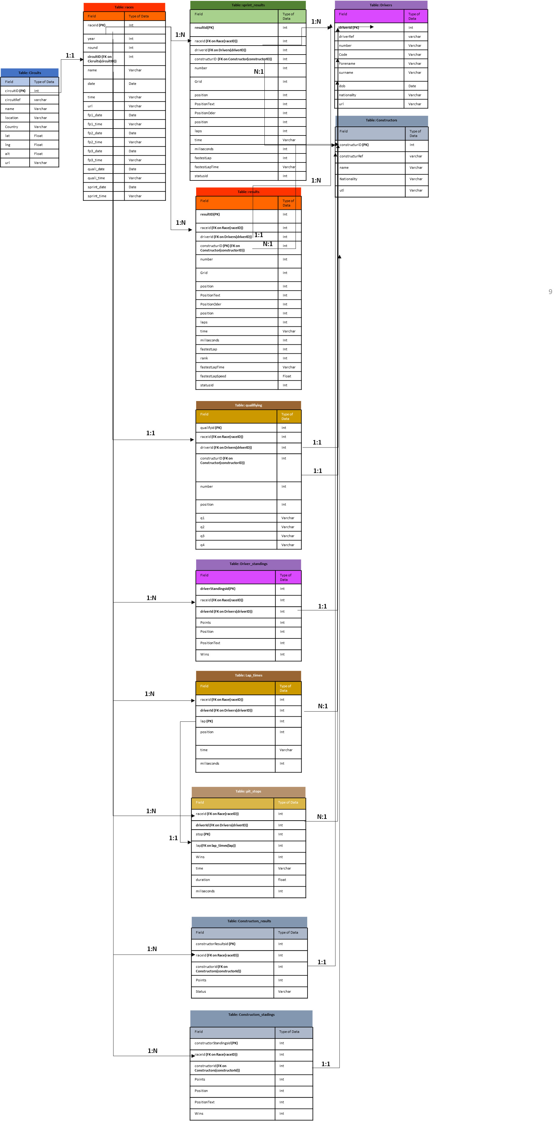
Se presenta la relación entre la distintas entidades de nuestra base Formula1
Notes:
Seasonality, trend and noise in time series data | Python (datacamp.com)

Slide 11
HIPOTESIS:
Se pretende analizar patrones, relaciones o tendencias en las distintas variables de estudio, por ejemplo.
¿Qué tantas veces aquel que empieza en primer lugar la carrera termina en primer lugar?
¿Existe una relación directa entre ganar Premios específicos
Notes:
Seasonality, trend and noise in time series data | Python (datacamp.com)

Slide 12

CODER HOUSE PROYECTO BASES DE DATOS TRANSFERMARKET
IBARRA SERGIO
JUNE 2023
Football Data from Transfermarkt | Kaggle

Slide 13
DATASET: Se decidió usar un dataset de Kaggle con información histórica futbolistas y sus precios de mercado
Se extrajo información acerca de cada precios de mercado de futbolistas
Esta información está dividida en muchas tablas tales como: appearances, club_games, clubs, competitions, game_events, games, player_valuations, players
Notes:
Seasonality, trend and noise in time series data | Python (datacamp.com)

Slide 14
Definiendo las distintas entidades y sus campos

Slide 15
Se decidió usar un dataset de Kaggle con información histórica de carreras de Transfermarkt
Table: Constructors
Field | Type of Data
constructurID (PK) | Int
constructurRef | varchar
name | Varchar
Nationality | Varchar
utl | Varchar
Table: appearances
Field | Type of Data
appearance_id (PK) | Varchar
game_id (FK on games(gameID)) | Int
player_id (FK on players(playerID)) | Int
player_club_id (FK on clubs(clubID)) | Int
player_current_club_id (FK on clubs(clubID)) | Int
competition_id(FK on clubs(clubID)) | Varchar
date | Date
player_name | Varchar
alt | Float
url | Varchar
Table: Constructors_results
Field | Type of Data
constructorResultsId (PK) | Int
raceId (FK on Race(raceID)) | Int
constructorId (FK on Constructors(constructorId)) | Int
Points | Int
Status | Varchar
Table: Constructors_stadings
Field | Type of Data
constructorStandingsId (PK) | Int
raceId (FK on Race(raceID)) | Int
constructorId (FK on Constructors(constructorId)) | Int
Points | Int
Position | Int
PositionText | Int
Wins | Int
Notes:
Seasonality, trend and noise in time series data | Python (datacamp.com)

